Slide 1
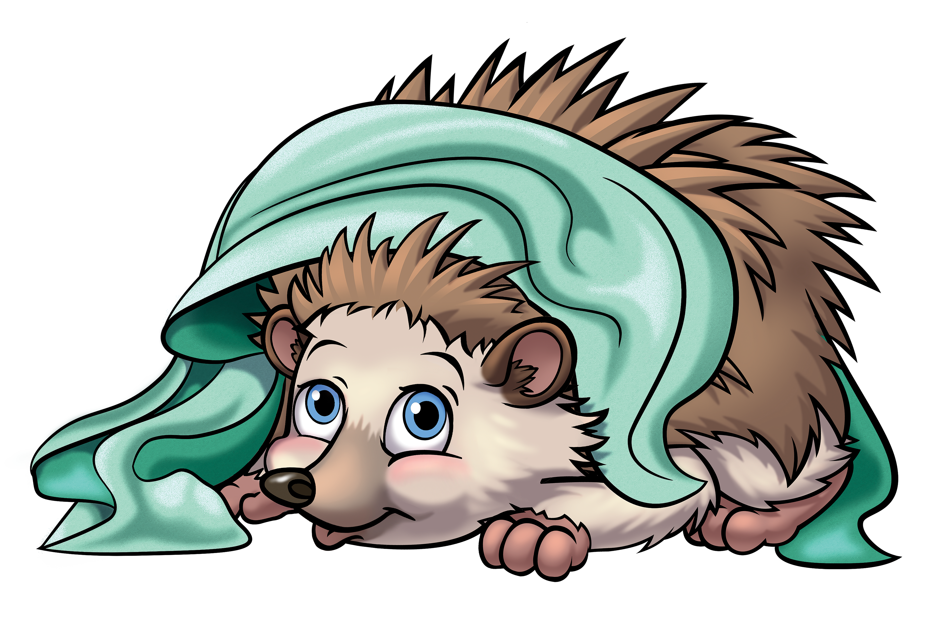
3. COMFORT

Slide 2
I wasn’t promised
Rainbows and sunshine
All the days of my life

Slide 3
And I know there will be
Some tears to shed,
Some clouds to weather
As I walk through this life

Slide 4
And It would be unbearable
If I didn’t have
Your Word, Your Love
They comfort me

Slide 5
Your peace and your kindness
Will sustain me.

Slide 6
Your Word, Your Love
They comfort me

Slide 7
Your peace and your kindness
Will sustain me.

Slide 8
I wasn’t promised
Rainbows and sunshine
All the days of my life

Slide 9
And I know there will be
Some tears to shed,
Some clouds to weather
As I walk through this life

Slide 10
And It would be unbearable
If I didn’t have
Your Word, Your Love
They comfort me

Slide 11
Your peace and your kindness
Will sustain me.

Slide 12
Your Word, Your Love
They comfort me

Slide 13
Your peace and your kindness
Will sustain me.

